Slide 1
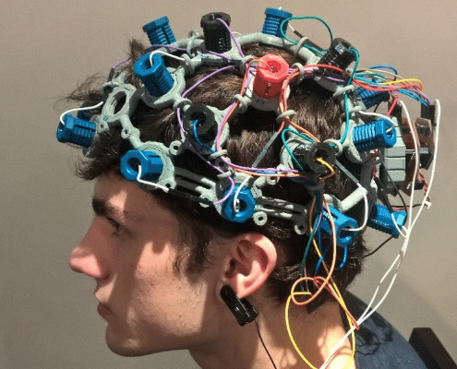
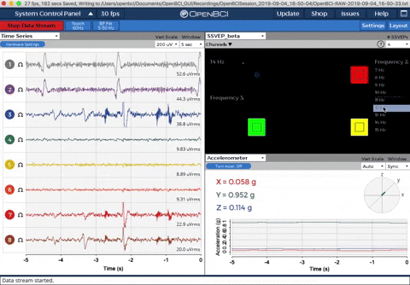
TITLE- Electroencephalogram Brain Signal Processing for Chromatic Visual Impression Identification.
(differentiate the brain signals from red and white colour)
Description- we are using openBCI device to record the signals from the brain, when the subject is shown only red and white colours. And then using signal scaling,filtering, extracting features and training models to differentiate between 2 colours(white or red).
Applications- if we are able to discriminate two different colours then we can use this as two control commands for controlling any dedicated computer applications.

Slide 2
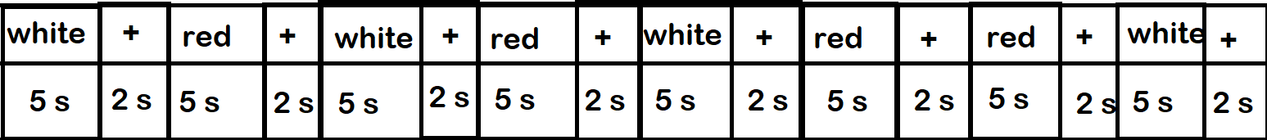
Plan of when and for how much duration to show red or white color:
+ -> fixation
Red -> red
White -> white
Total time- 340 s (5.66 min)
50 colours shown

Slide 3
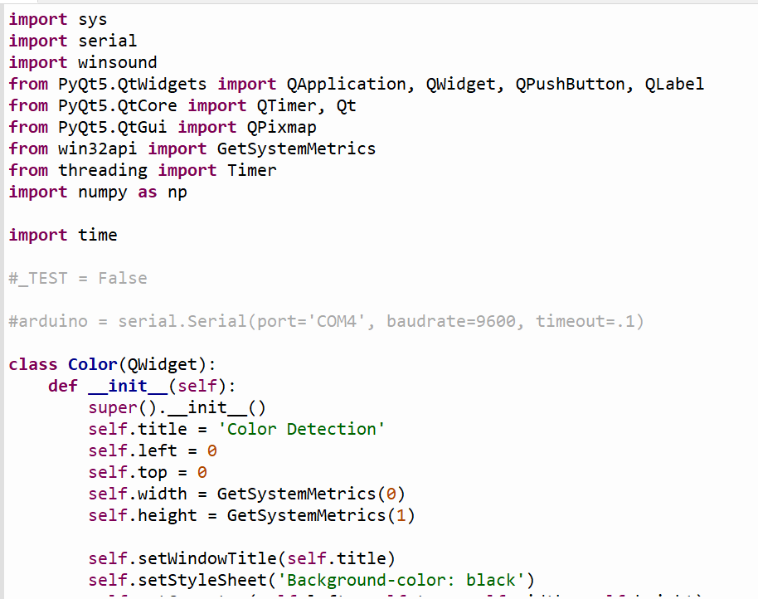
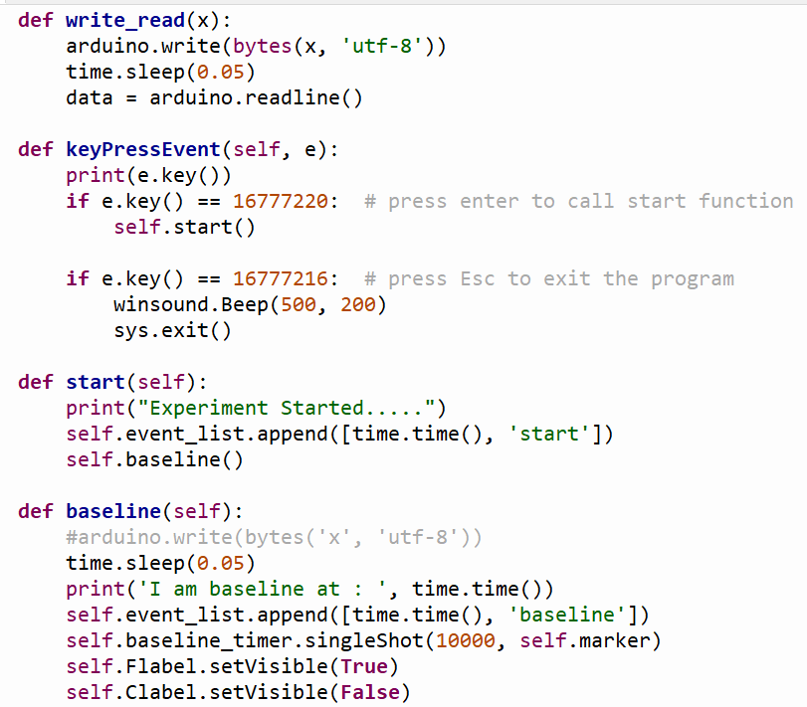
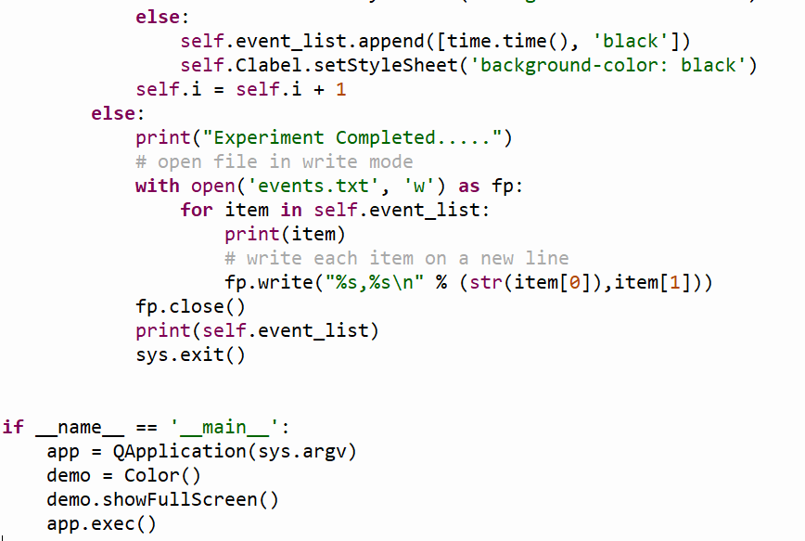
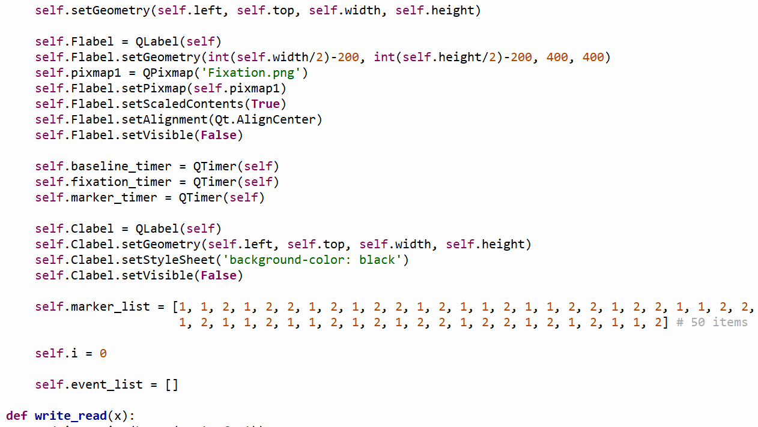
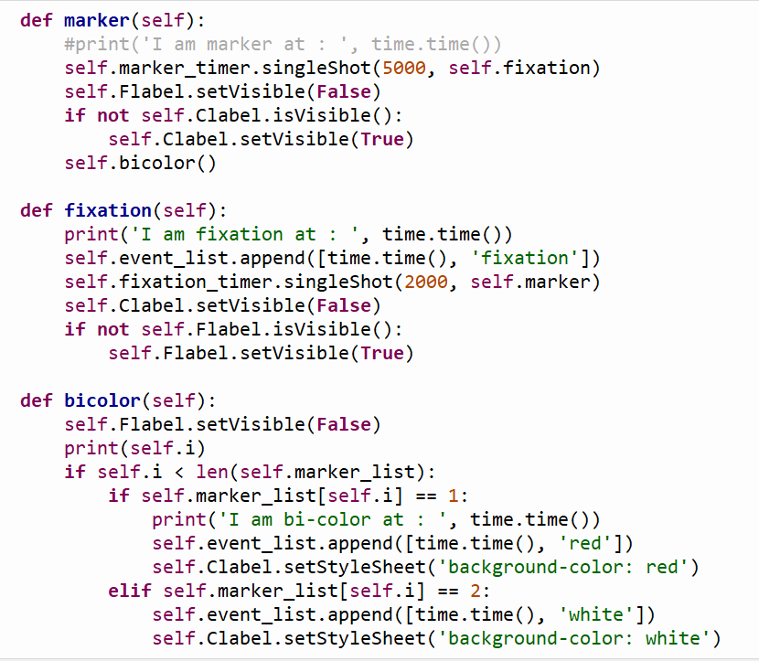
python Script we wrote to achieve the desired plan of showing red and white colour described in previous slide.

Slide 4
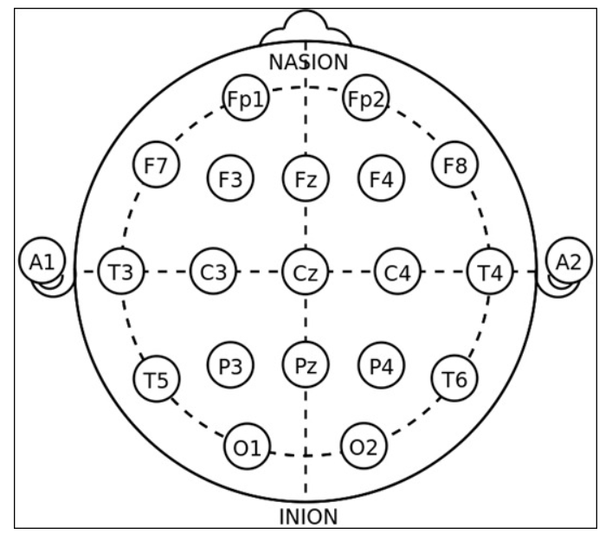
Step by step process we used OpenBCI to collect the brain signals data.
Setting the hardware part
1.) decide which which portion of the subject’s head you want to measure the data from by setting the points on the headset. We are using fp1,fp2,c3,c4,p3,p4,o1,o2 as visual stimuli is measured by the back of the head and using ………………….. as support electrodes.
2.)make the subject wear this headset kit and make it comfortable on the subject’s head by adjust the supporting and non-supporting electrodes(which actually gives us data) to get the brain signals as a data properly.
3.) put the SRB pin clip to the right ear to get all be measured against this reference pin.
4.) connect dongle to the PC

Slide 5
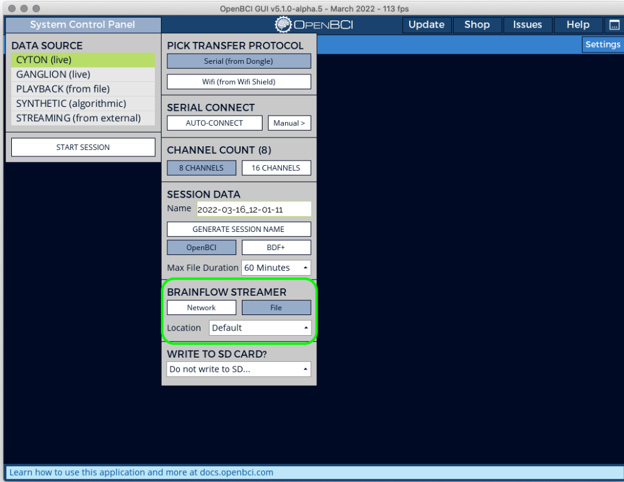
Setting the software part
1.) installing Softwares - a) OpenBCI GUI b) driver for support < windows 11
2.) Open the openBCI GUI. Click on system control panel -> CYTON(live) ->Serial from Dongle . and then click on SERIAL CONNECT->AUTO-CONNECT. to get the data from the electrodes in headset into the PC through the Dongle.

Slide 6
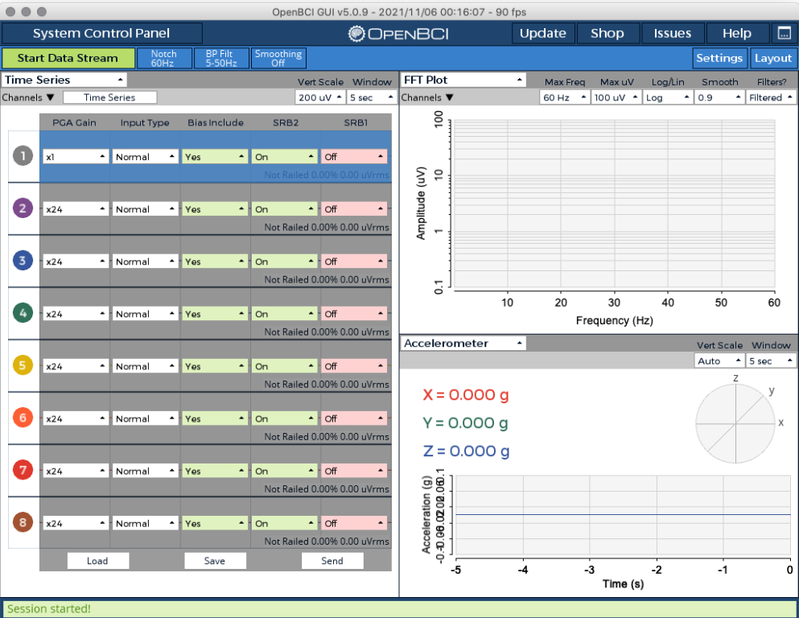
3.) Now session is started, completing the hardware settings:-
set the PGA gain= 4 (…why…) and bias include = No (….why…) for all the 8 channels.

Slide 7
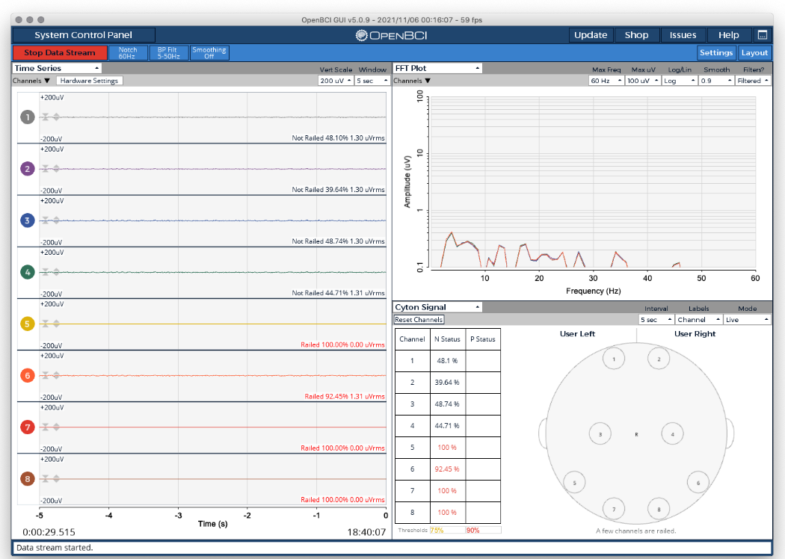
4.) Now for checking the signal quality :-
Go to the FFT plot and try to put not railed for all the channels for good quality of signal. Now we are ready to collect the signals.

Slide 8
5.) for stop collecting the data click on stop data stream . Data for this session will get saved as .txt and .csv format and events.txt file also got saved using the python script we wrote.

Slide 9
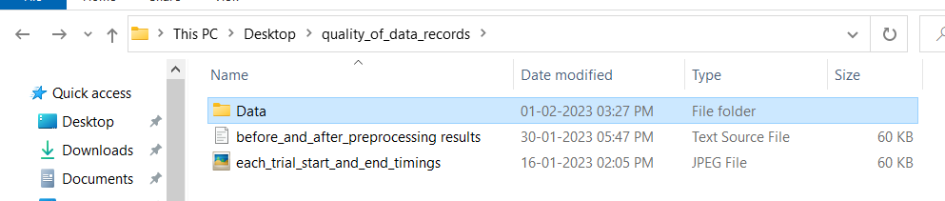
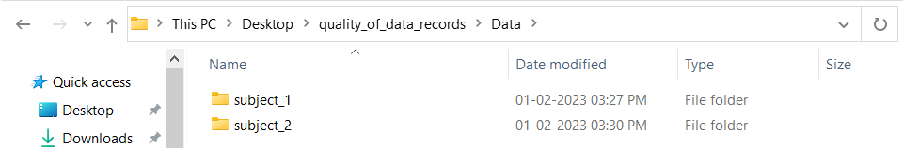
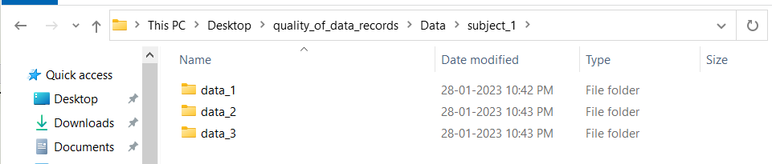
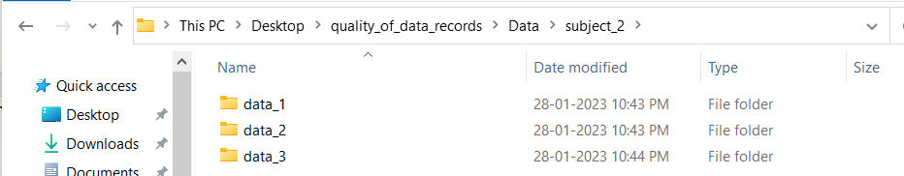
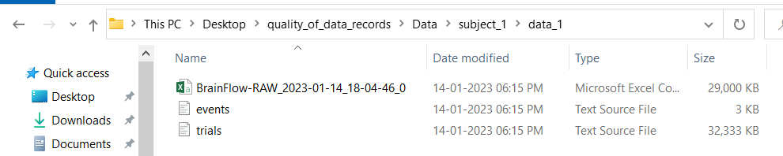
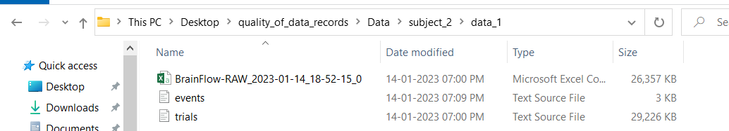
HOW WE ORGANIZED THE DATA

Slide 10
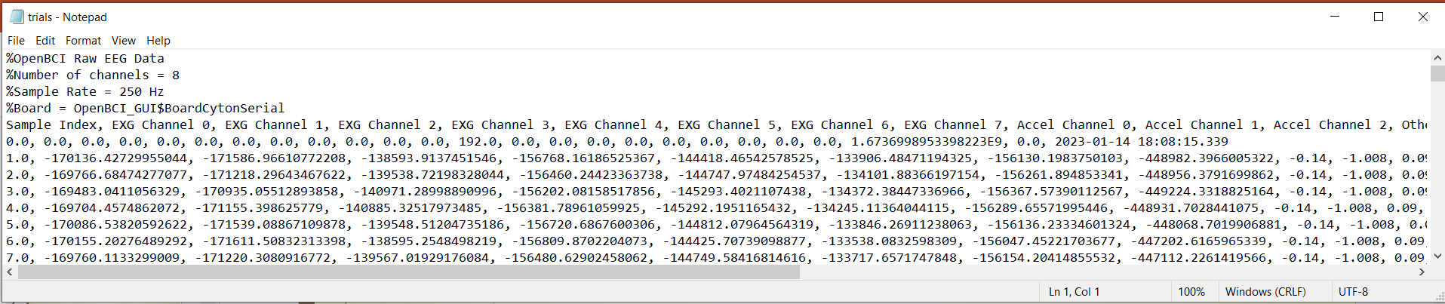
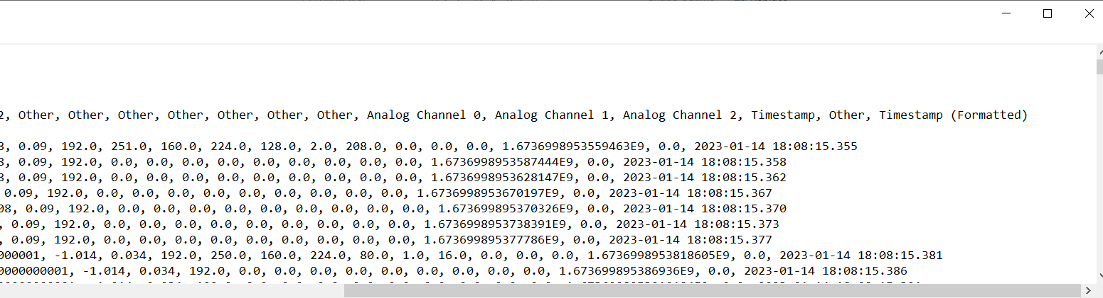
DATA WE HAVE
open the trials.txt file on which the data got saved in this format.

Slide 11
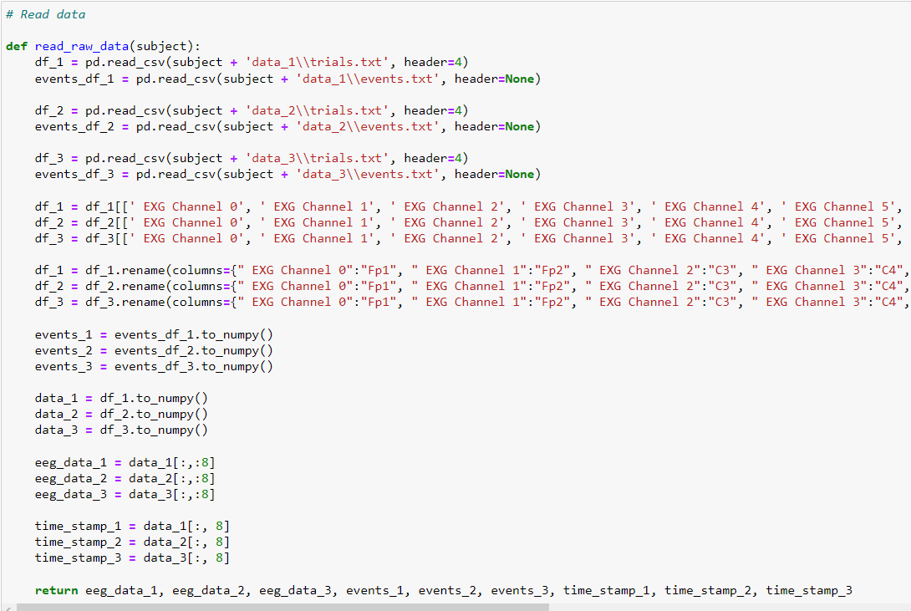
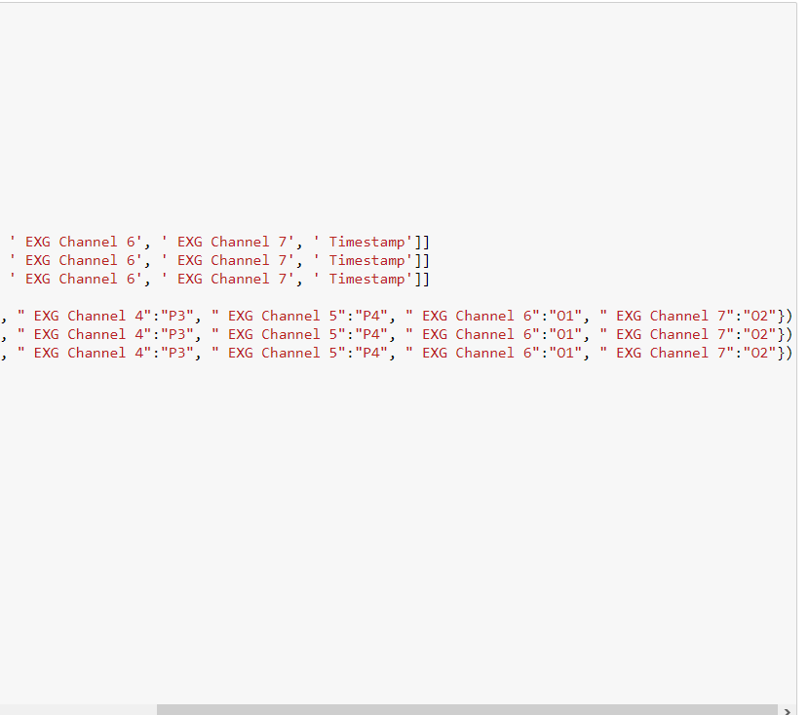
In our Jupyter notebook python script
We filter out the data of only (all the 8 channels and the time stamp).
Renamed the channels
eeg_data -> data of all the 8 channels, time_stamp -> time stamps of the data collected

Slide 12
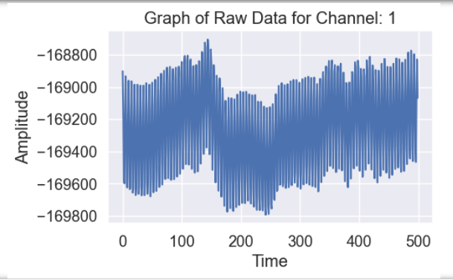
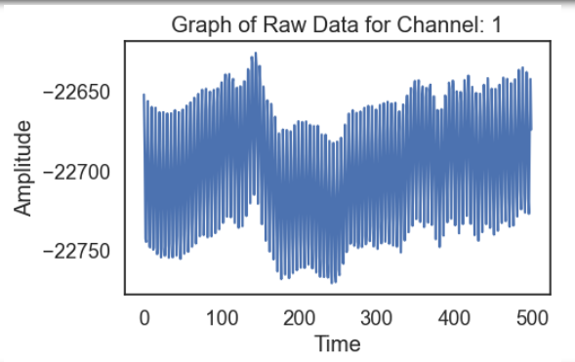
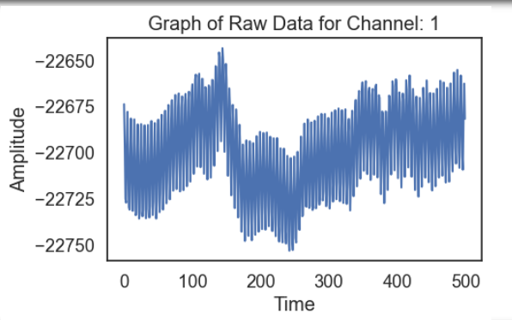
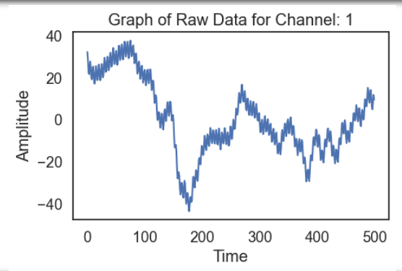
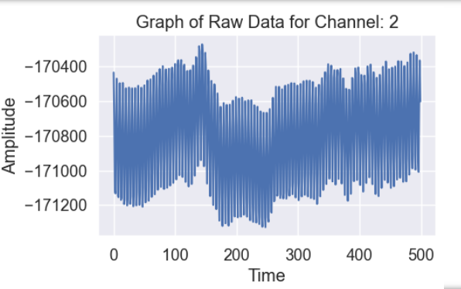
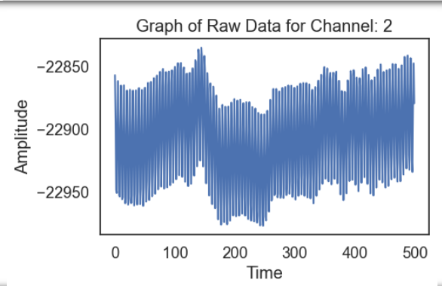
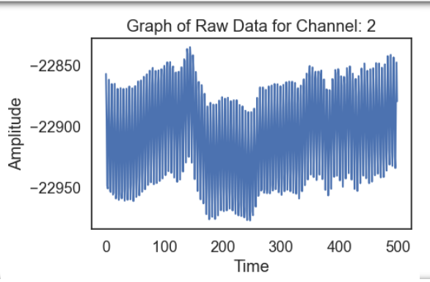
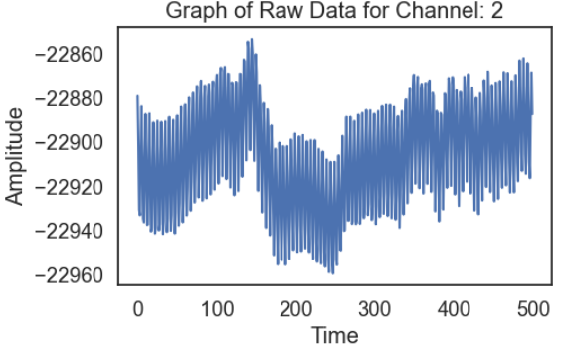
Time vs Amplitude plots of subject_1_data_1 each channel (1-8)
Channel_1
Raw data
Scaled, notch filter
Scaled, notch, band pass filter
scaled
Channel_2
Raw data
scaled
Scaled, notch filter
Scaled, notch, band pass filter

Slide 13
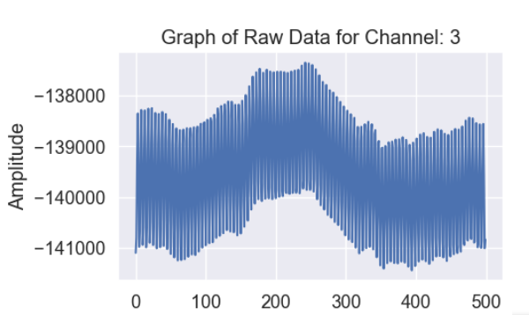
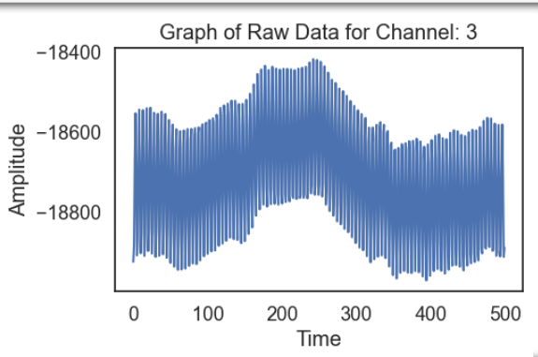
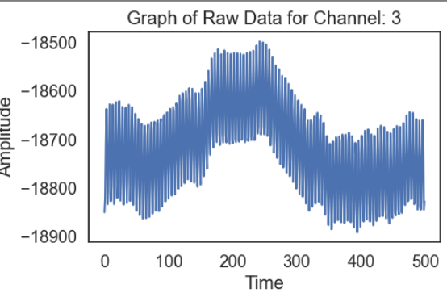
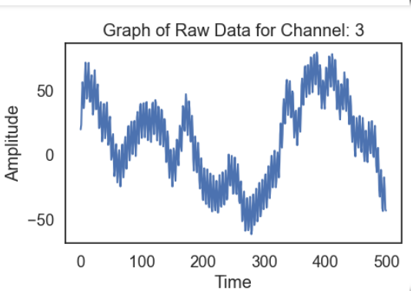
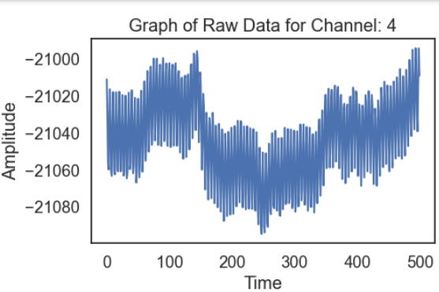
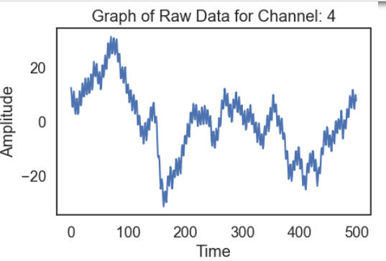
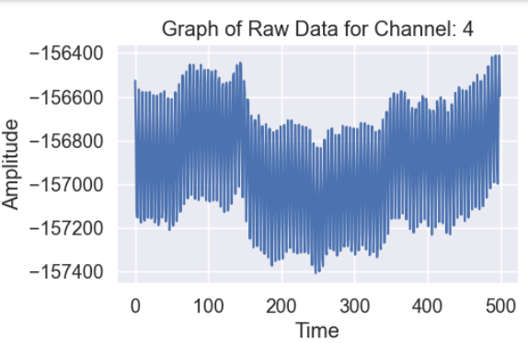
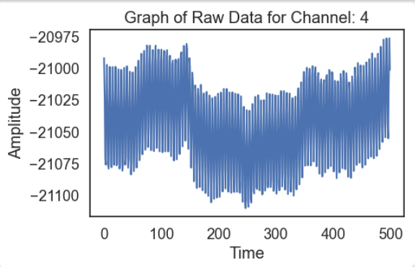
Channel 3
Scaled, notch,
band pass filter
Raw data
scaled
Scaled, notch filter
Channel 4
Scaled, notch,
band pass filter
Raw data
Scaled, notch filter
scaled

Slide 14
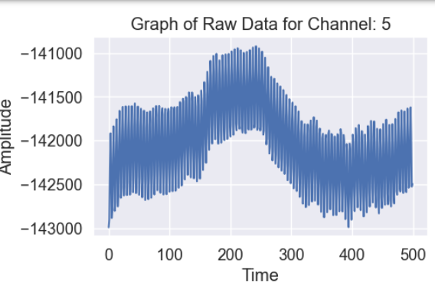
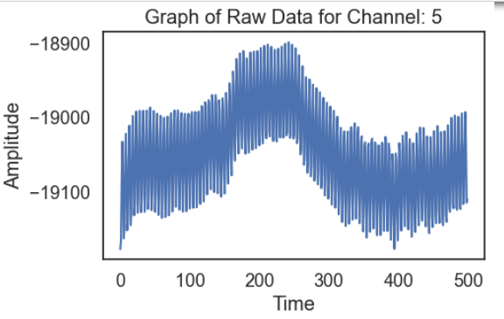
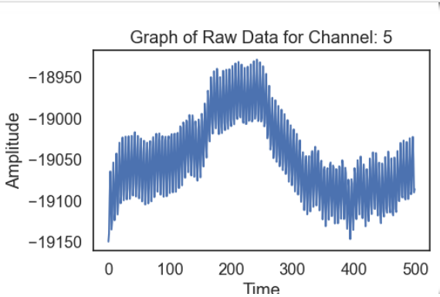
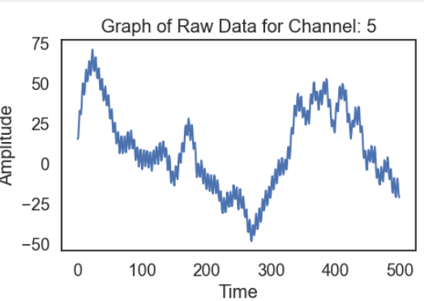
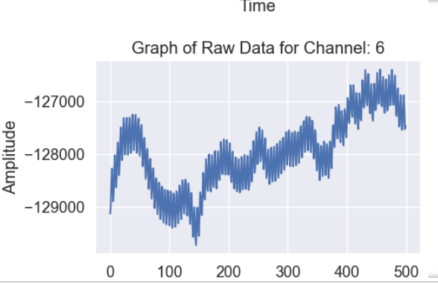
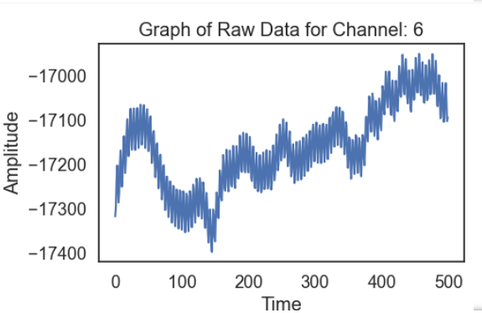
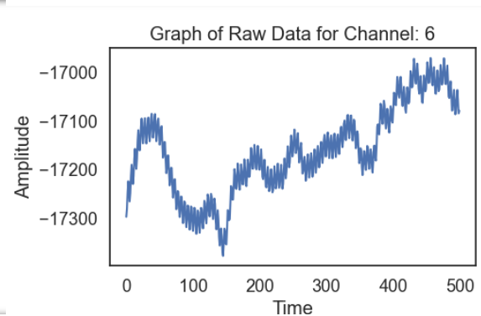
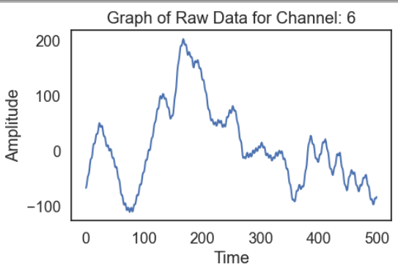
Channel 5
Scaled, notch,
band pass filter
Raw data
scaled
Scaled, notch filter
Channel 6
Scaled, notch,
band pass filter
Raw data
Scaled, notch filter
scaled

Slide 15
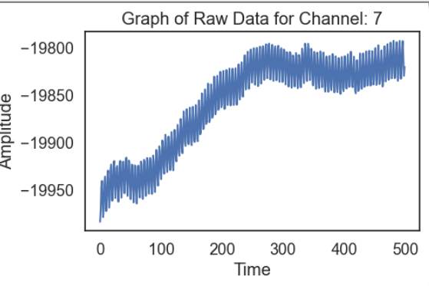
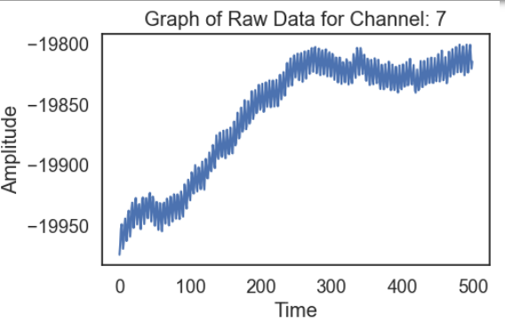
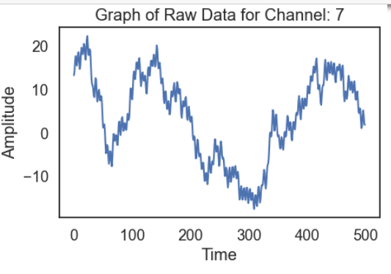
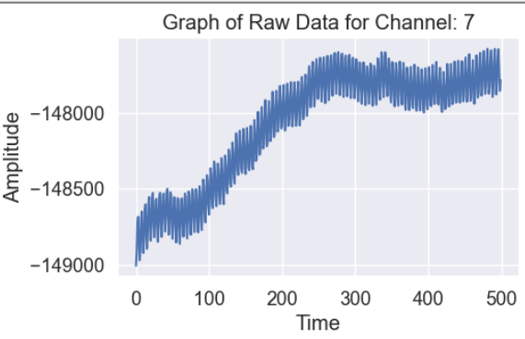




Channel 7
Scaled, notch,
band pass filter
Raw data
scaled
Scaled, notch filter
Channel 8
Scaled, notch,
band pass filter
Raw data
scaled
Scaled, notch filter

Slide 16








Time vs Amplitude plots of subject_1_data_2 each channel (1-8)
Channel_1
Raw data
Scaled, notch filter
Scaled, notch, band pass filter
scaled
Channel_2
Raw data
scaled
Scaled, notch filter
Scaled, notch, band pass filter

Slide 17








Channel 3
Scaled, notch,
band pass filter
Raw data
scaled
Scaled, notch filter
Channel 4
Scaled, notch,
band pass filter
Raw data
Scaled, notch filter
scaled

Slide 18








Channel 5
Scaled, notch,
band pass filter
Raw data
scaled
Scaled, notch filter
Channel 6
Scaled, notch,
band pass filter
Raw data
Scaled, notch filter
scaled

Slide 19








Channel 7
Scaled, notch,
band pass filter
Raw data
scaled
Scaled, notch filter
Channel 8
Scaled, notch,
band pass filter
Raw data
scaled
Scaled, notch filter

Slide 20








Time vs Amplitude plots of subject_1_data_3 each channel (1-8)
Channel_1
Raw data
Scaled, notch filter
Scaled, notch, band pass filter
scaled
Channel_2
Raw data
scaled
Scaled, notch filter
Scaled, notch, band pass filter

Slide 21








Channel 3
Scaled, notch,
band pass filter
Raw data
scaled
Scaled, notch filter
Channel 4
Scaled, notch,
band pass filter
Raw data
Scaled, notch filter
scaled

Slide 22








Channel 5
Scaled, notch,
band pass filter
Raw data
scaled
Scaled, notch filter
Channel 6
Scaled, notch,
band pass filter
Raw data
Scaled, notch filter
scaled

Slide 23








Channel 7
Scaled, notch,
band pass filter
Raw data
scaled
Scaled, notch filter
Channel 8
Scaled, notch,
band pass filter
Raw data
scaled
Scaled, notch filter

Slide 24








Time vs Amplitude plots of subject_2_data_1 each channel (1-8)
Channel_1
Raw data
Scaled, notch filter
Scaled, notch, band pass filter
scaled
Channel_2
Raw data
scaled
Scaled, notch filter
Scaled, notch, band pass filter

Slide 25








Channel 3
Scaled, notch,
band pass filter
Raw data
scaled
Scaled, notch filter
Channel 4
Scaled, notch,
band pass filter
Raw data
Scaled, notch filter
scaled

Slide 26








Channel 5
Scaled, notch,
band pass filter
Raw data
scaled
Scaled, notch filter
Channel 6
Scaled, notch,
band pass filter
Raw data
Scaled, notch filter
scaled

Slide 27








Channel 7
Scaled, notch,
band pass filter
Raw data
scaled
Scaled, notch filter
Channel 8
Scaled, notch,
band pass filter
Raw data
scaled
Scaled, notch filter

Slide 28








Time vs Amplitude plots of subject_2_data_2 each channel (1-8)
Channel_1
Raw data
Scaled, notch filter
Scaled, notch, band pass filter
scaled
Channel_2
Raw data
scaled
Scaled, notch filter
Scaled, notch, band pass filter

Slide 29








Channel 3
Scaled, notch,
band pass filter
Raw data
scaled
Scaled, notch filter
Channel 4
Scaled, notch,
band pass filter
Raw data
Scaled, notch filter
scaled

Slide 30








Channel 5
Scaled, notch,
band pass filter
Raw data
scaled
Scaled, notch filter
Channel 6
Scaled, notch,
band pass filter
Raw data
Scaled, notch filter
scaled

Slide 31








Channel 7
Scaled, notch,
band pass filter
Raw data
scaled
Scaled, notch filter
Channel 8
Scaled, notch,
band pass filter
scaled
Scaled, notch filter
Raw data

Slide 32








Time vs Amplitude plots of subject_2_data_3 each channel (1-8)
Channel_1
Raw data
Scaled, notch filter
Scaled, notch, band pass filter
scaled
Channel_2
Raw data
scaled
Scaled, notch filter
Scaled, notch, band pass filter

Slide 33








Channel 3
Scaled, notch,
band pass filter
Raw data
scaled
Scaled, notch filter
Channel 4
Scaled, notch,
band pass filter
Raw data
Scaled, notch filter
scaled

Slide 34








Channel 5
Scaled, notch,
band pass filter
Raw data
scaled
Scaled, notch filter
Channel 6
Scaled, notch,
band pass filter
Raw data
Scaled, notch filter
scaled

Slide 35








Channel 7
Scaled, notch,
band pass filter
Raw data
scaled
Scaled, notch filter
Channel 8
Scaled, notch,
band pass filter
scaled
Scaled, notch filter
Raw data

Slide 36
From (108582,8) matrix ------>
By filtering out only the time stamps when the red or white colour was shown.
(50colors)
Also each second 256 readings were recorded, by splitting the data secondwise and removing the last 6 readings from each of the seconds
Further splitting the each of the 50 colours(which are of 5 sec each) into 5 readings.
So we are getting (250,250,8) matrix for each session
No.
of
trials
in each
second
Each
second
channels
Then we concatenated all the 3 sessions readings of subject_1 together also we concatenated all the 3 sessions readings of subject_2 together
Then we got (750,250,8) matrix for each of the subject_1 and subject_2

Slide 37
Then the features we extracted from this kind of organized data-
1.)Mean , 2.)Standard deviation, 3.)Skewness, 4.)Kurtosis, 5.)DCT features, 6.)Wavelet features, 7.)Bandpowers
(750,250,8) matrix data ---🡪 (750,96) data for each of subject_1 and subject_2
…………………………………………………………………………………………………………………………………………..
Train test split
70% train, 30% test
We trained our data on following models and checked the accuracy and other factors
1.) SVM(SVC(kernel = 'linear'), 2.)SVM(SVC(kernel = 'rbf')), 3.)random forest classifier,
4.) LinearDiscriminantAnalysis, 5.) DecisionTreeClassifier, 6.) GaussianNB,
7.) KNeighborsClassifier, 8.)AdaBoostClassifier

Slide 38




Models on Subject_1
With mean, median, skewness, kurtosis,DCT,wavelet,bandpower as features
SVM(SVC(kernel = 'linear')
SVM(SVC(kernel = 'rbf'))
random forest classifier,
LinearDiscriminantAnalysis

Slide 39




DecisionTreeClassifier,
GaussianNB,
KNeighborsClassifier,
AdaBoostClassifier

Slide 40




Models on Subject_2
With mean, median, skewness, kurtosis,DCT,wavelet,bandpower as features
SVM(SVC(kernel = 'linear')
SVM(SVC(kernel = 'rbf'))
random forest classifier,
LinearDiscriminantAnalysis

Slide 41




DecisionTreeClassifier,
GaussianNB,
KNeighborsClassifier,
AdaBoostClassifier

Slide 42
Thank you

